Slide 1
Adversarial attack
Aryaman Gautam J001

Slide 2
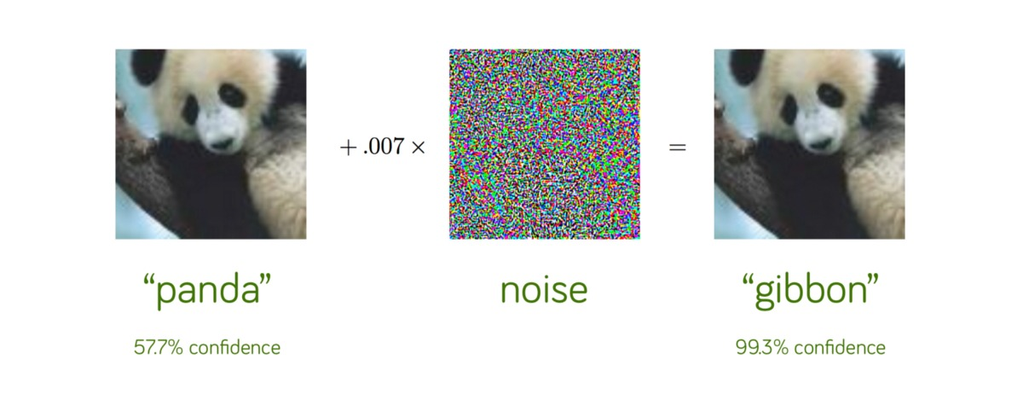
Adversarial attack

Slide 3
Why do they occur?
Overfitting ?
Underfitting ?
Linearity.

Slide 4
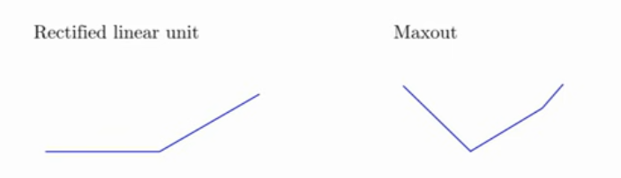
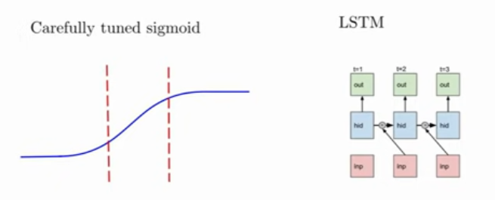

Slide 5
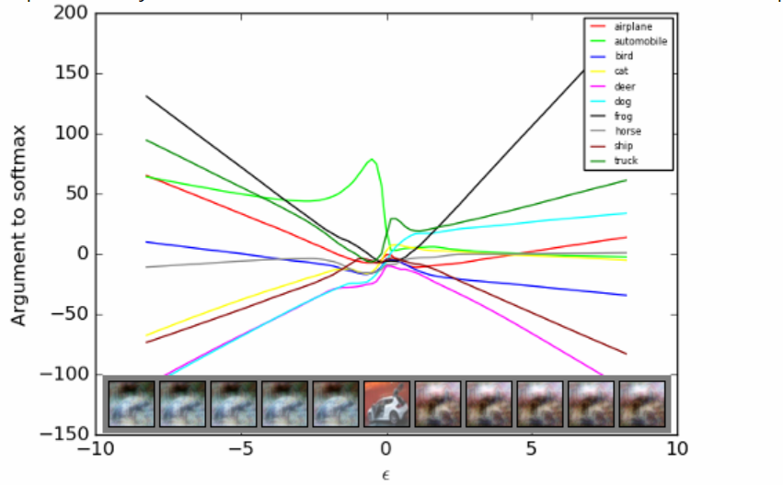

Slide 6
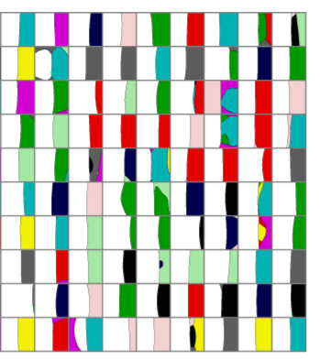
Cross – section of decision space

Slide 7
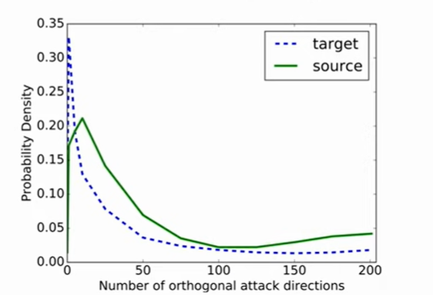
Dimensionality

Slide 8
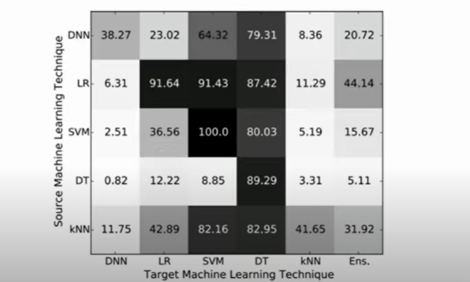
Cross model

Slide 9
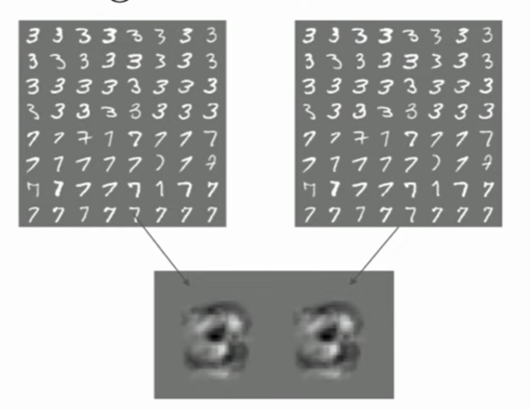
Cross Dataset classification

Slide 10
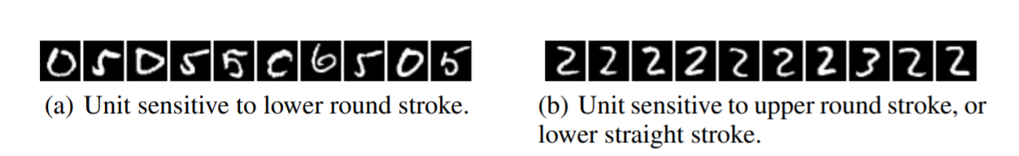
To Recap

Slide 11
Threat models
Adversary’s Goal :
Poisoning vs Evasion Attack
Targeted Attack vs Non-Targeted Attack

Slide 12
BASED on adversary’s knowledge
Black Box
Grey Box
White Box

Slide 13
PERTRUBATION METRICS
L0 distance corresponds to the number of pixels that have been altered in an image.
1
L2 distance measures the standard Euclidean (rootmean-square) distance between x and x 0
2
L∞ distance measures the maximum change to any of the coordinates
3

Slide 14
Some Examples OF adversarial attacks

Slide 15


lBFGS: Limited Memory Broyden-Fletcher-Goldfarb-Shanno algorithm
It searches for the minima distorted adversarial example and to find it the algorithm treats it as an optimization problem with the objective :

Slide 16


Fast Gradient Sign Method
It is a one-step method is introduced to fast generate adversarial examples.
It is designed to quickly find a perturbation direction for a given input such that the training loss function of the target model will increase, reducing classification confidence and increasing the likelihood of inter-class confusion

Slide 17

BIM
Iteration Updation :
adversarial example generated are defined as:

Slide 18
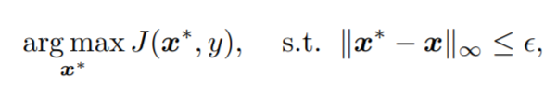
Momentum Iterative attack
Won first places in the non-targeted adversarial attack and targeted adversarial attack competitions (black-box setting) at the 2017 Neural Information Processing Systems (NIPS) conference.

Slide 19
Iterative Least Likely Class Method
A variant of BIM where the goal is to generate an adversarial example which is misclassified as a specific target t.
The iterative update is given by

Slide 20
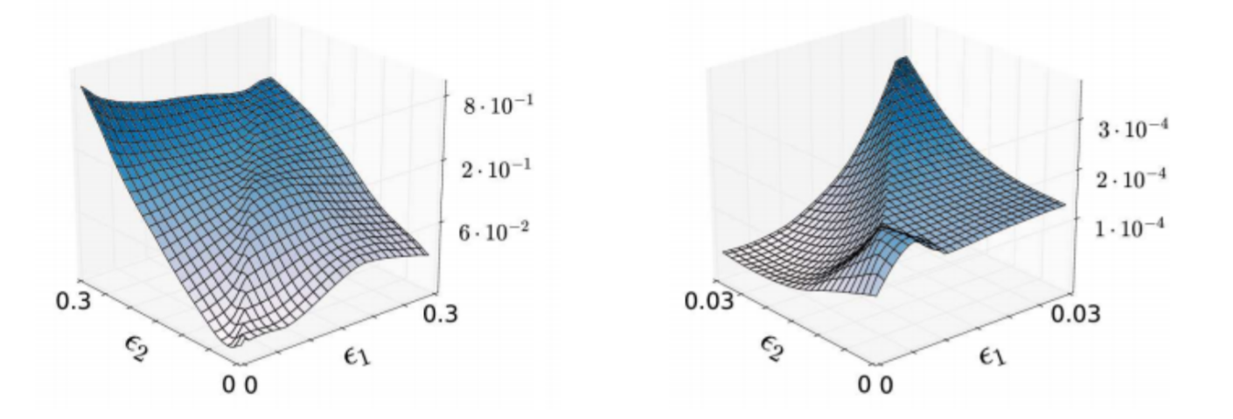
R+FGSM
The randomized single-step attack, or R+FGSM , adds a small random perturbation to the input before applying the adversarial perturbation generated by FGSM.

Slide 21
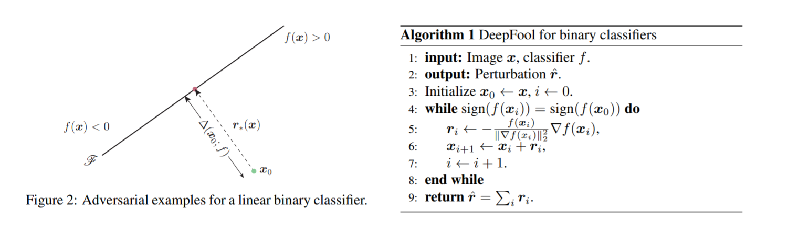
Deepfool
estimates the distance of an input instance x to the closest decision boundary of a multi-class classifier and can be used as minimal adversarial perturbation direction

Slide 22
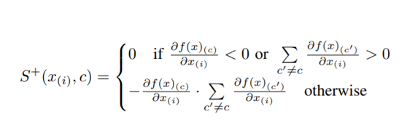
Jacobian-based Saliency Map Attacks
The notion of the saliency map was originally conceived for visualizing how deep neural networks make predictions

Slide 23
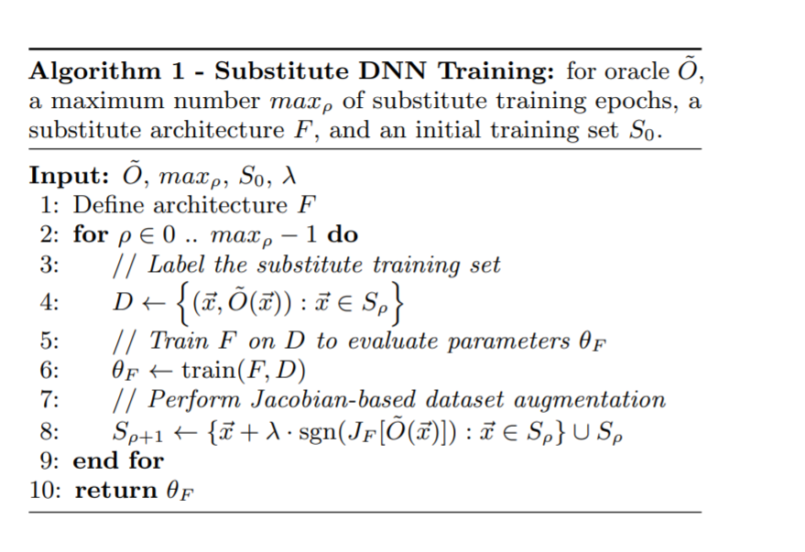
Substitute Blackbox Attack

Slide 24
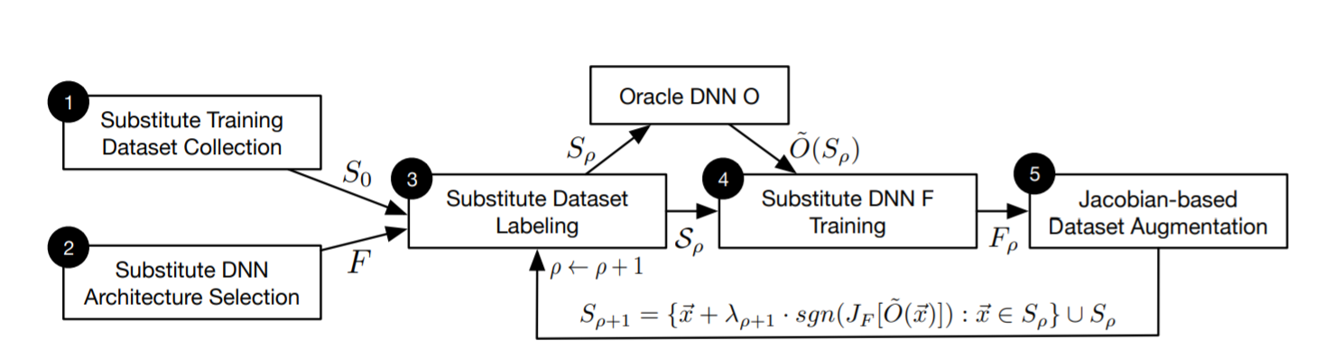

Slide 25
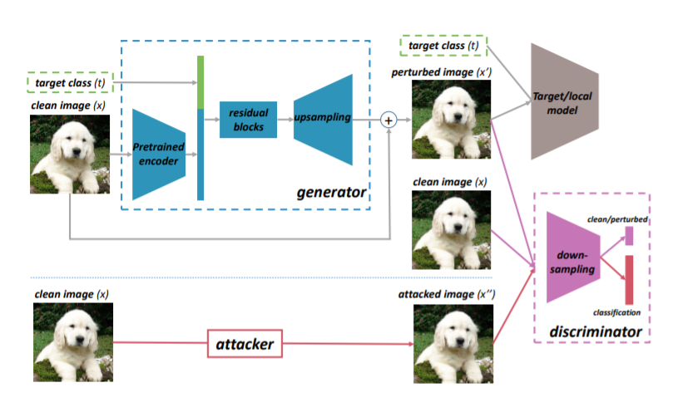
GAN

Slide 26
Bibliography
https://arxiv.org/pdf/1312.6199.pdf
http://s3.amazonaws.com/arena-attachments/607118/47d10e7cf5b482846aea40dcc3c58f4d.pdf?1462316194
https://arxiv.org/pdf/1712.07107.pdf
https://arxiv.org/pdf/1602.02697.pdf
https://arxiv.org/pdf/1608.04644v2.pdf
https://arxiv.org/pdf/1911.05268v2.pdf#page=85&zoom=100,102,233
https://arxiv.org/pdf/1808.07945.pdf
https://arxiv.org/pdf/2002.02196.pdf
https://arxiv.org/pdf/1810.00069.pdf
https://arxiv.org/pdf/1807.10454v3.pdf
https://arxiv.org/pdf/1710.06081.pdf
https://arxiv.org/pdf/1511.04599.pdf
https://arxiv.org/pdf/1607.02533.pdf
https://www.sciencedirect.com/science/article/pii/S209580991930503X

Slide 27
THANK YOU

